Slide 1
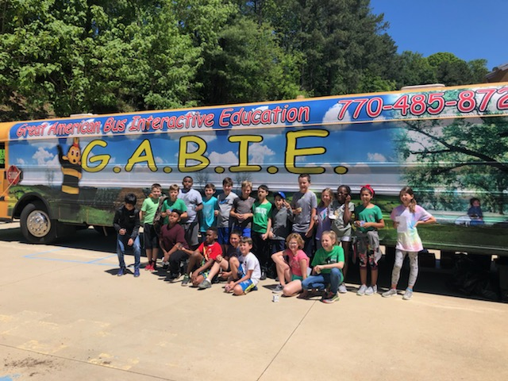

Slide 2
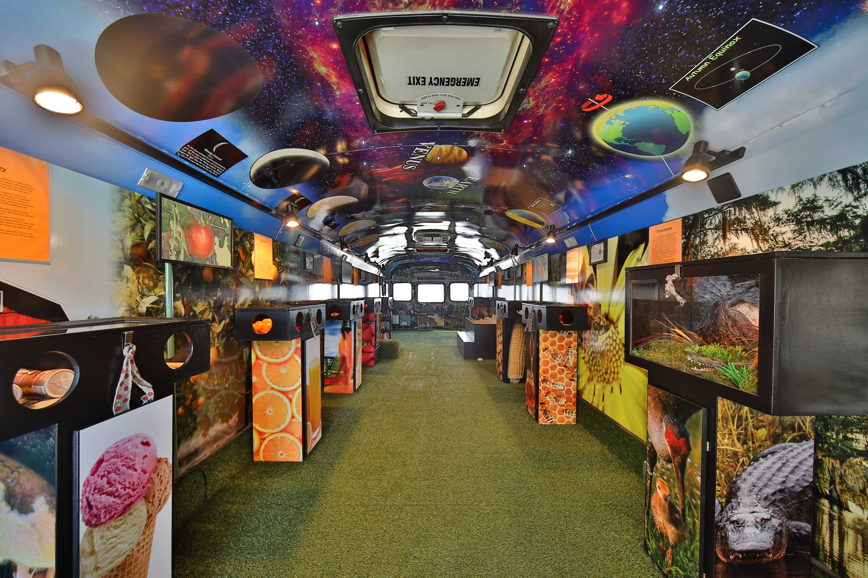
Bee-Wise About Agriculture
The GABIE Bus is a curriculum based, mobile, interactive experience
that brings the field trip to the kids!

Slide 3
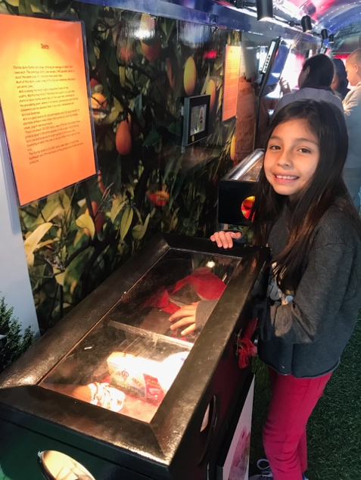
What’s all the buzz?
“When GABIE the ‘in house field trip’ comes to our school, the program fits right into our curriculum in science and more, and the children love it!”
- Martha Stadifer, Paulding County, GA teacher
The GABIE Bus is a refurbished pre-owned school bus outfitted with fun, experiential learning stations that coordinate with Pre—K through middle school S.T.R.E.A.M. (Science, Technology, Reading, Engineering, Art and Mathematics) education standards.
The Stations can be adapted to reflect the state and community’s agriculture to educate children about healthy eating and sustainable practices.

Slide 4
The WHY
Nutrition is critical for a child’s growth, development and learning
According to the U.S. Department of Agriculture (USDA), more than 12 million children in the U.S. live in “food insecure” homes
Experiential learning has the highest impact for learning retention
Teachers are challenged to plan field trips for students, due to complexity, risk, staffing, and more
As a substitute teacher in Atlanta, GA, Lisa Williams witnessed children not having access to food or the “know how” to grow their own. She was inspired to create the Great American Bus Interactive Education (GABIE) system.
***Great for schools, but also for day care visits, local fairs, camps, church-affiliated programs and more!

Slide 5
Gallery- CURRENT OPERATORS
BUSES OPERATING IN ATLANTA, TAMPA, SE FLORIDA (MIAMI/FT LAUD/WEST PALM)

Slide 6
Advantages & Unique Value
Passive or active ownership – up to them!
No direct competition in category
Home based office - No brick and mortar location
Simple to operate and scalable
Coordinates with S.T.R.E.A.M curriculum requirements –
Schools LOVE us!
Low staffing requirement – only 3 to 4 (no experience req)
Low overhead and high margins – 70%+
Seamless and speedy ramp up – less than 90 days!
Lifestyle friendly with flexibility – take summers and weekends off!
BEST PART- Six Figure Income Potential – ITEM 19!!
Happy franchisees already with great validation!
GABIE is on a mission to ”pollinate” kids with
agriculture KNOWLEDGE
and KNOW HOW!
Win-win-win for students, teachers and GABIE franchisees!

Slide 7
Ideal Candidate
Demonstrates entrepreneurial spirit
Looking for steady growth
Desire to grow into multiple markets
Committed to enriching the lives of children
Enthusiastic and likeable personality
Values community relationships
Can train, manage and motivate team members
Understands how to follow a system
Strong organizational skills
Meets financial requirements
NO EXPERIENCE NECESSARY!
Training in Atlanta or Tampa, FL for 3 days
Changing lives…
one field trip at a time!

Slide 8
Investment Overview
SINGLE BUS
Franchise Fee
$35,000 first unit
$20,000 each additional
Total Investment
$97,050 to $142,700
Minimum Cash Investment
$35,000 liquid assets
Minimum Net Worth
$150,000
Royalty
8% of gross sales
National Marketing Fund
$100 per month
Furnishings, Fixtures, Equipment
Included in total investment
*AVAILABLE & SELLING IN ALL STATES

